Slide 1

Chapter 15
Algorithms for Query Processing and Optimization

Slide 2
0. Introduction to Query Processing (1)
Query optimization:
The process of choosing a suitable execution strategy for processing a query.
Two internal representations of a query:
Query Tree
Query Graph

Slide 3
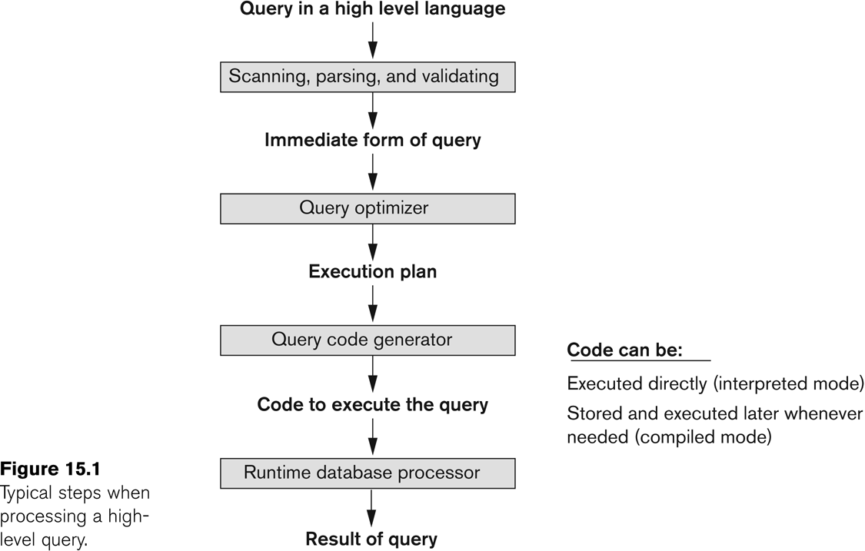
Introduction to Query Processing (2)

Slide 4
1. Translating SQL Queries into Relational Algebra (1)
Query block:
The basic unit that can be translated into the algebraic operators and optimized.
A query block contains a single SELECT-FROM-WHERE expression, as well as GROUP BY and HAVING clause if these are part of the block.
Nested queries within a query are identified as separate query blocks.
Aggregate operators in SQL must be included in the extended algebra.

Slide 5
Translating SQL Queries into Relational Algebra (2)
SELECT LNAME, FNAME
FROM EMPLOYEE
WHERE SALARY > ( SELECT MAX (SALARY)
FROM EMPLOYEE
WHERE DNO = 5);
SELECT LNAME, FNAME
FROM EMPLOYEE
WHERE SALARY > C
SELECT MAX (SALARY)
FROM EMPLOYEE
WHERE DNO = 5
π_{LNAME, FNAME} (σ_{SALARY>C}(EMPLOYEE))
ℱ_{MAX SALARY} (σ_{DNO=5} (EMPLOYEE))

Slide 6
Using Heuristics in Query Optimization (2)
Query tree:
A tree data structure that corresponds to a relational algebra expression. It represents the input relations of the query as leaf nodes of the tree, and represents the relational algebra operations as internal nodes.
An execution of the query tree consists of executing an internal node operation whenever its operands are available and then replacing that internal node by the relation that results from executing the operation.

Slide 7
Using Heuristics in Query Optimization (3)
Example:
For every project located in ‘Stafford’, retrieve the project number, the controlling department number and the department manager’s last name, address and birthdate.
Relation algebra:
πPNUMBER, DNUM, LNAME, ADDRESS, BDATE (((σ_{PLOCATION=‘STAFFORD’}(PROJECT)) _{DNUM=DNUMBER} (DEPARTMENT)) _{MGRSSN=SSN} (EMPLOYEE))
SQL query:
Q2: SELECT P.NUMBER,P.DNUM,E.LNAME, E.ADDRESS, E.BDATE
FROM PROJECT AS P,DEPARTMENT AS D, EMPLOYEE AS E
WHERE P.DNUM=D.DNUMBER AND D.MGRSSN=E.SSN AND P.PLOCATION=‘STAFFORD’;

Slide 8
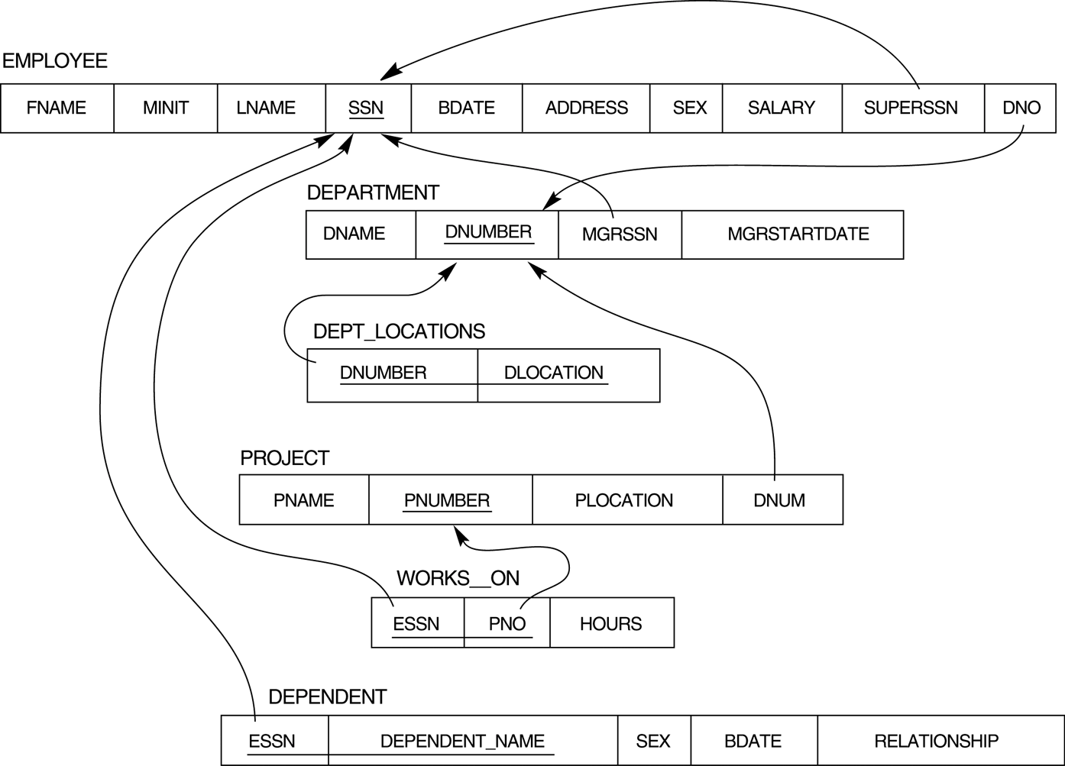
FIGURE 7.2 Result of mapping the COMPANY ER schema into a relational schema.

Slide 9
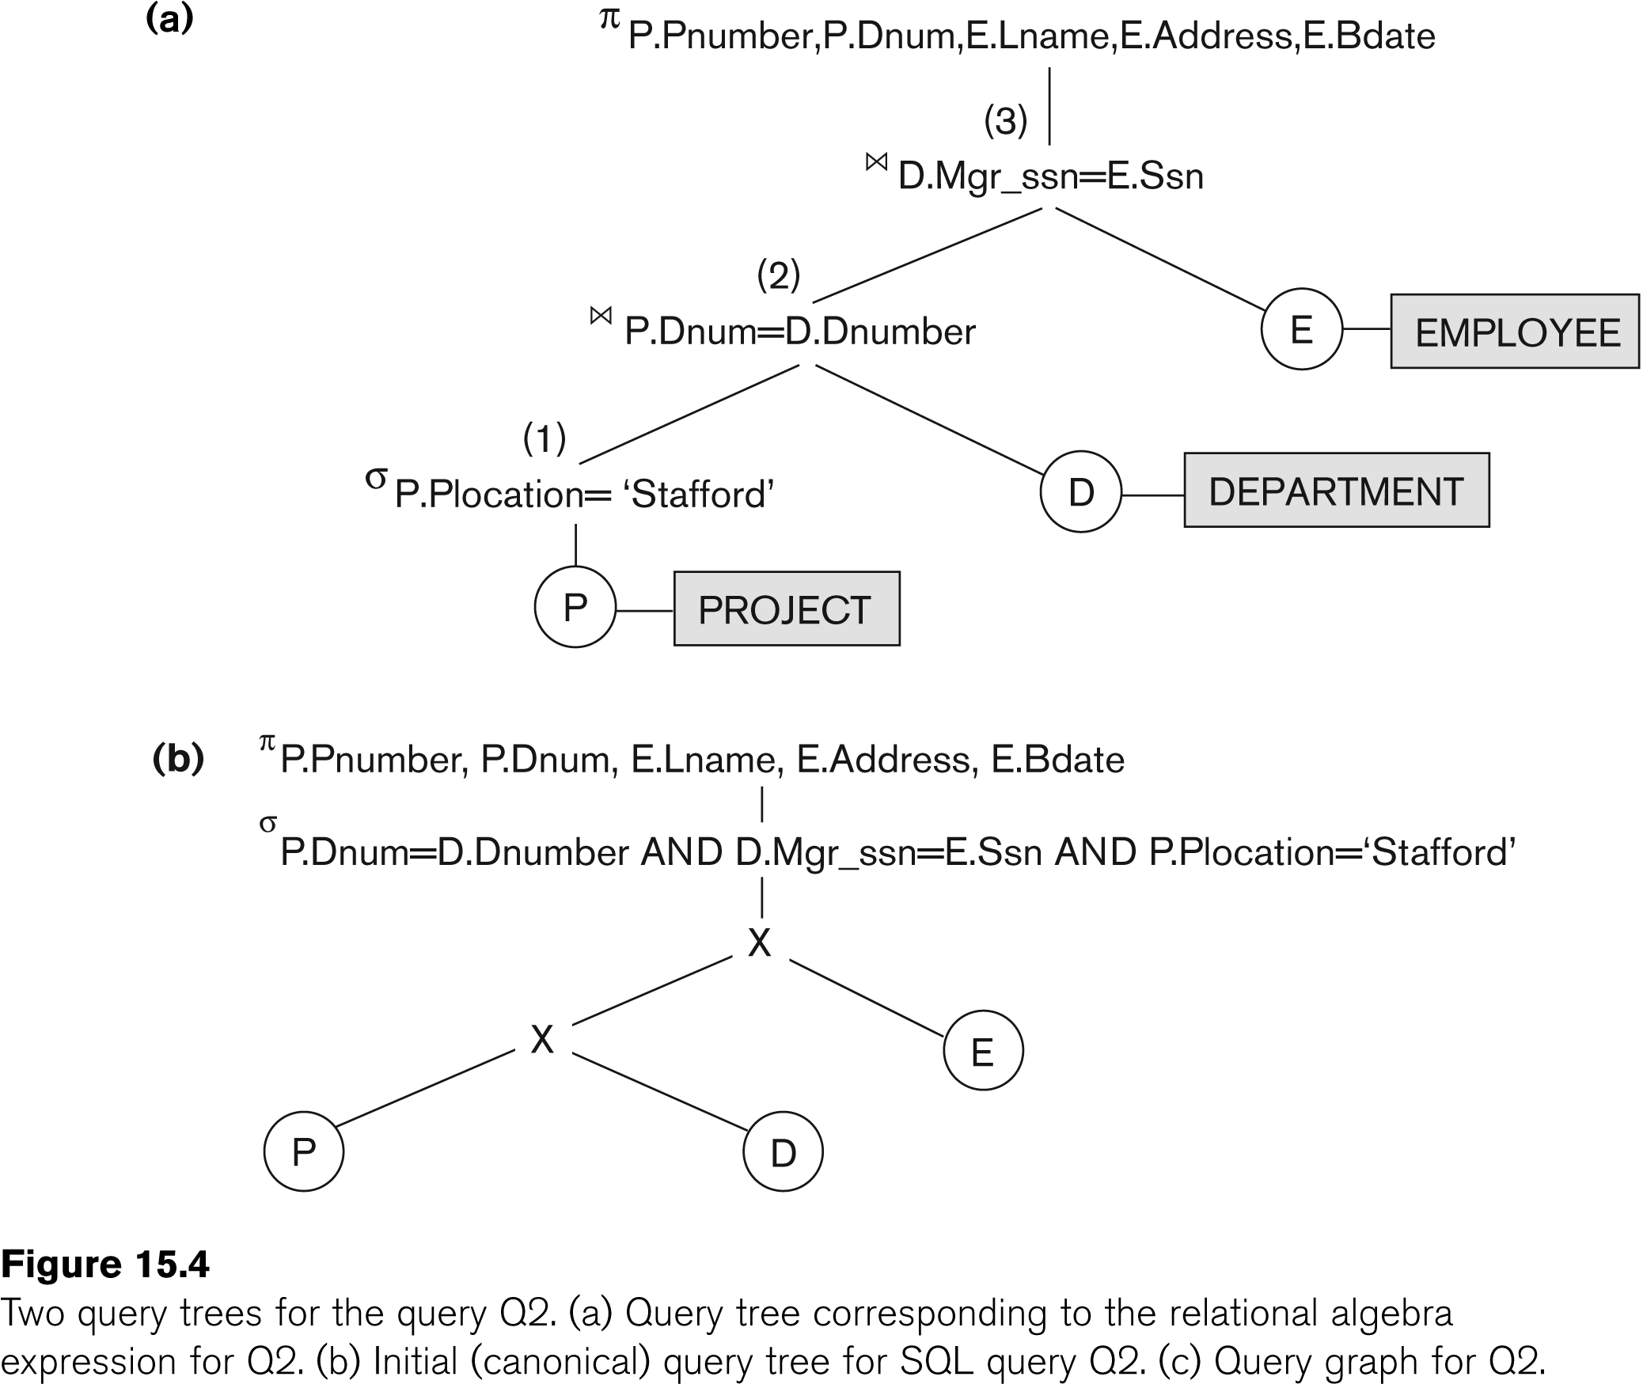
Using Heuristics in Query Optimization (4)

Slide 10
Using Heuristics in Query Optimization (6)
Heuristic Optimization of Query Trees:
The same query could correspond to many different relational algebra expressions — and hence many different query trees.
The task of heuristic optimization of query trees is to find a final query tree that is efficient to execute.
Find the last names of employees born after 1957 who work on a project named ‘Aquarius’.
Example:
Q: SELECT LNAME
FROM EMPLOYEE, WORKS_ON, PROJECT
WHERE PNAME = ‘AQUARIUS’ AND PNMUBER=PNO AND ESSN=SSN AND BDATE > ‘1957-12-31’;

Slide 11
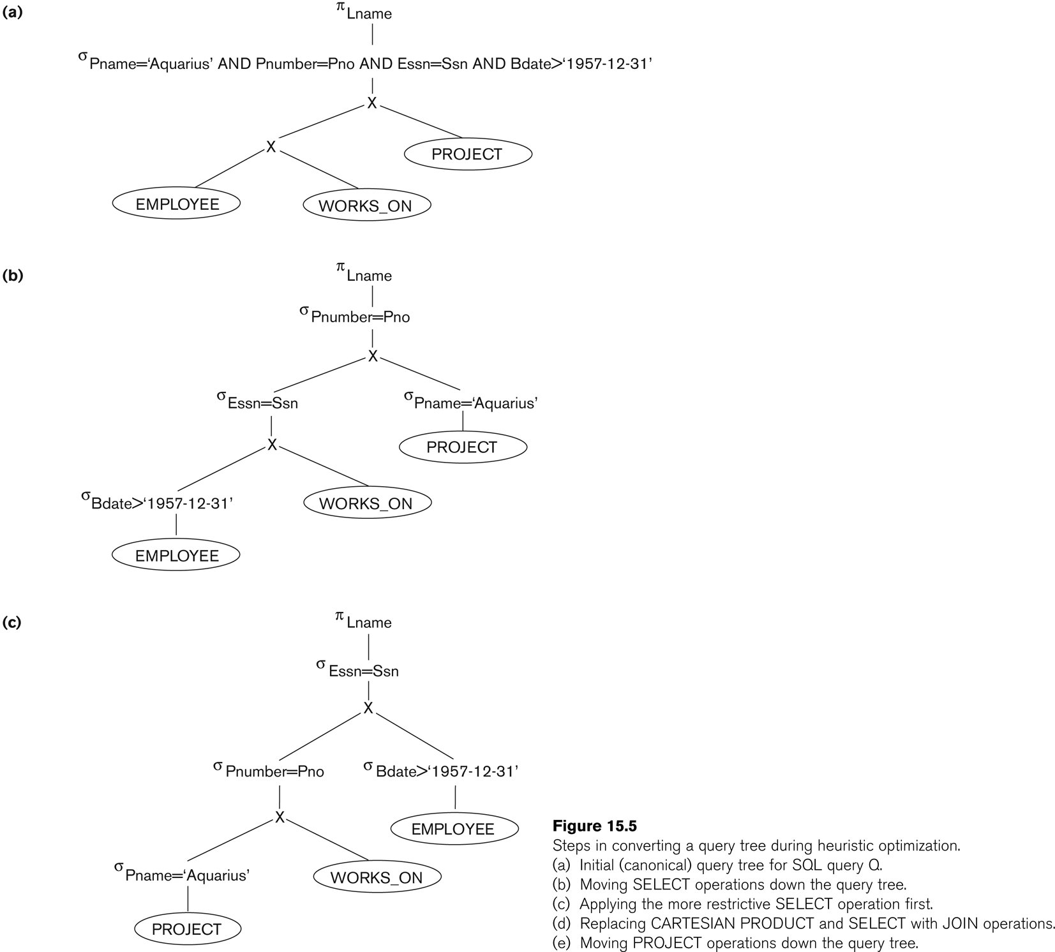
Using Heuristics in Query Optimization (7)

Slide 12
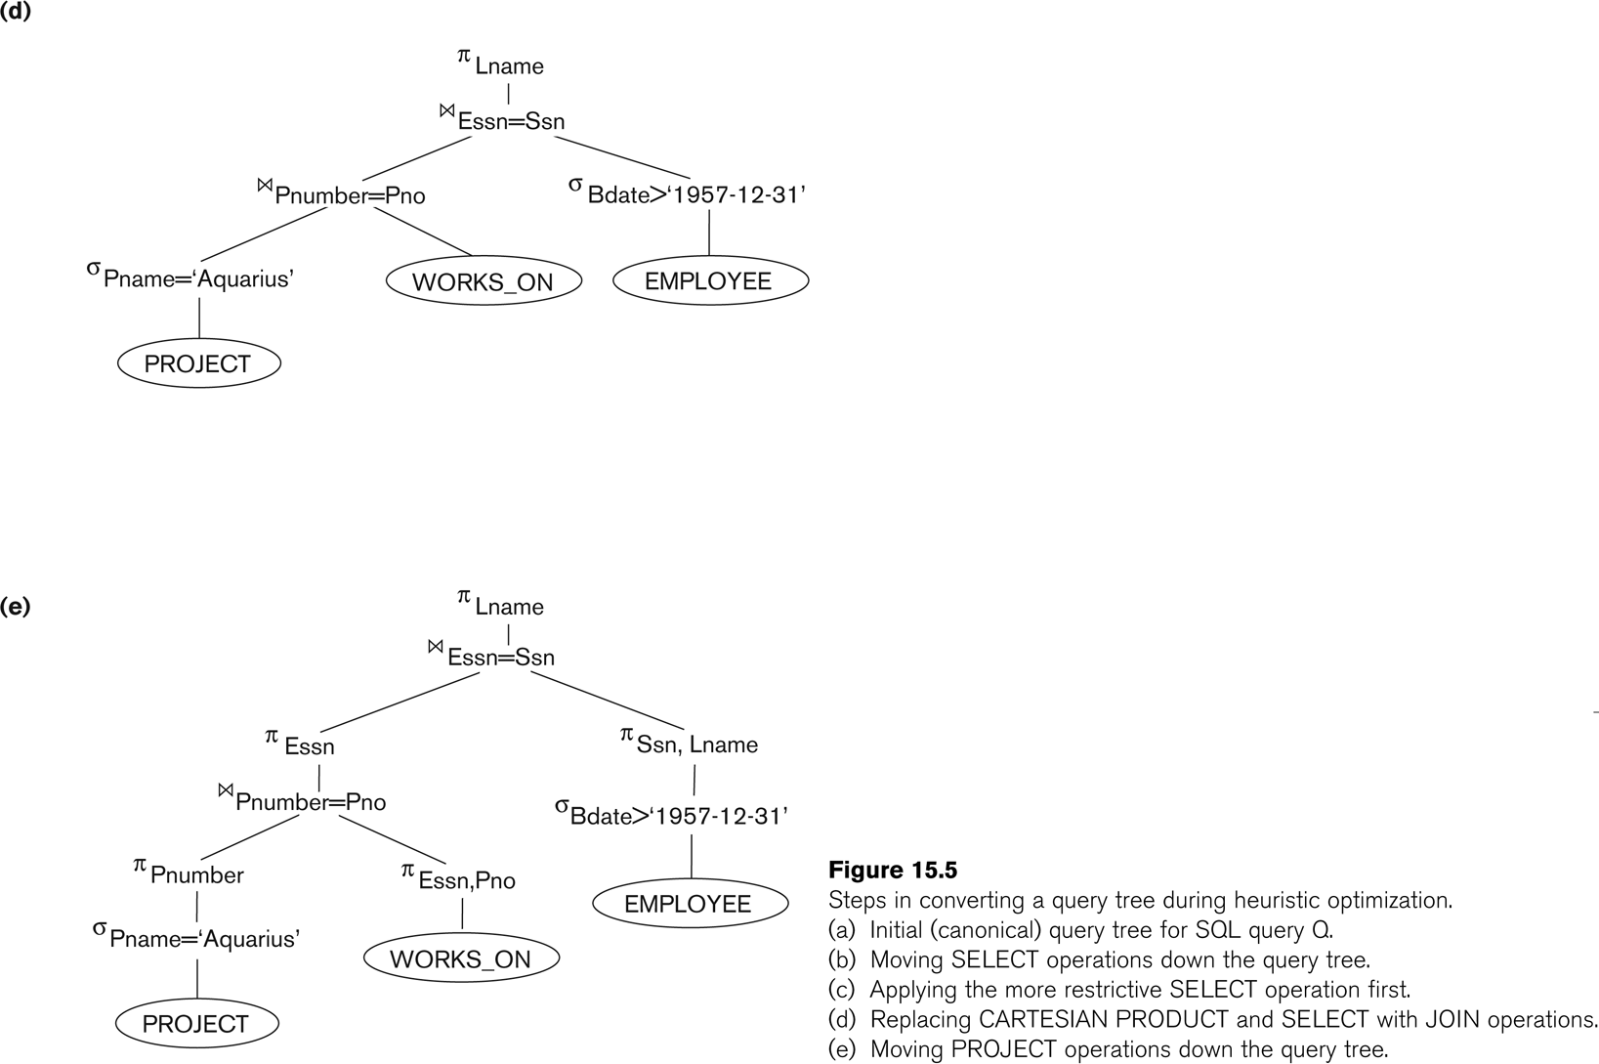
Using Heuristics in Query Optimization (8)

Slide 13
Using Heuristics in Query Optimization (15)
Summary of Heuristics for Algebraic Optimization:
The main heuristic is to apply first the operations that reduce the size of intermediate results.
Perform select operations as early as possible to reduce the number of tuples and perform project operations as early as possible to reduce the number of attributes. (This is done by moving select and project operations as far down the tree as possible.)
The select and join operations that are most restrictive should be executed before other similar operations. (This is done by reordering the leaf nodes of the tree among themselves and adjusting the rest of the tree appropriately.)

Slide 14
Using Heuristics in Query Optimization (16)
Query Execution Plans
An execution plan for a relational algebra query consists of a combination of the relational algebra query tree and information about the access methods to be used for each relation as well as the methods to be used in computing the relational operators stored in the tree.
Materialized evaluation: the result of an operation is stored as a temporary relation.
Pipelined evaluation: as the result of an operator is produced, it is forwarded to the next operator in sequence.

